Slide 1

Development of Real Estate Listing Platform with Advanced Search and Map Integration
Presented by:
Aizaz Khalid 154 2021-Agr-U-49041
Ahmed Maaz 336 2021-Agr-U-49220
Supervisor: Dr Muhammad Ishaq
The University of Agriculture, Peshawar-Pakistan
Institute of Computer Science & Information Technology (ICS/IT)
Date: 21 April, 2025

Slide 2
Overview of the project
Purpose:
Simplify real estate listings with advanced search and map integration.
Importance:
Helps buyers, renters, and agents efficiently find properties.
Enhances user experience with interactive maps and smart filtering.
Bridges the gap between property seekers and sellers with a modern, tech-driven approach.

Slide 3
Problem Statement
Traditional real estate platforms lack efficient filtering and interactive map-based searches
Users struggle to find properties that match their exact requirements
The need for a modern, user-friendly, and feature-rich platform

Slide 4
Objectives
Develop an intuitive real estate platform with a seamless user experience.
Implement advanced search functionalities to allow precise property filtering.
Integrate interactive maps for location-based property discovery.
Enhance user engagement with a modern, user-friendly interface.
Facilitate efficient property management for buyers, renters, and agents.

Slide 5
Features
Advanced Property Search – Filter listings based on price, location, property type, and amenities.
Interactive Map Integration – Search and explore properties using a dynamic map interface.
User Authentication & Profiles – Secure login and personalized dashboards for buyers, renters, and agents.
Real-Time Listings Management – Add, update, and manage property listings with ease.
Responsive & Modern UI – User-friendly design optimized for all devices.

Slide 6
Tech Stack
Frontend:
Next.js (React) – For a fast and dynamic user interface.
Tailwind CSS – For a sleek, responsive, and modern design.
ShadCN – For pre-built, accessible UI components.
Lucide Icons – For modern and customizable icons.
Mapping & Search:
Google Maps API / Advance Search Map API – For interactive map and Advance Searching integration.

Slide 7
Backend & Database:
Supabase – For database management and cloud-based backend services.
Database – PostgreSQL for data storage provided by Supabase.
Authentication:
Clerk SDK – For secure user authentication and management.
Hosting & Deployment:
Vercel – For seamless deployment and performance optimization.
GitHub – For version control and collaboration.

Slide 8
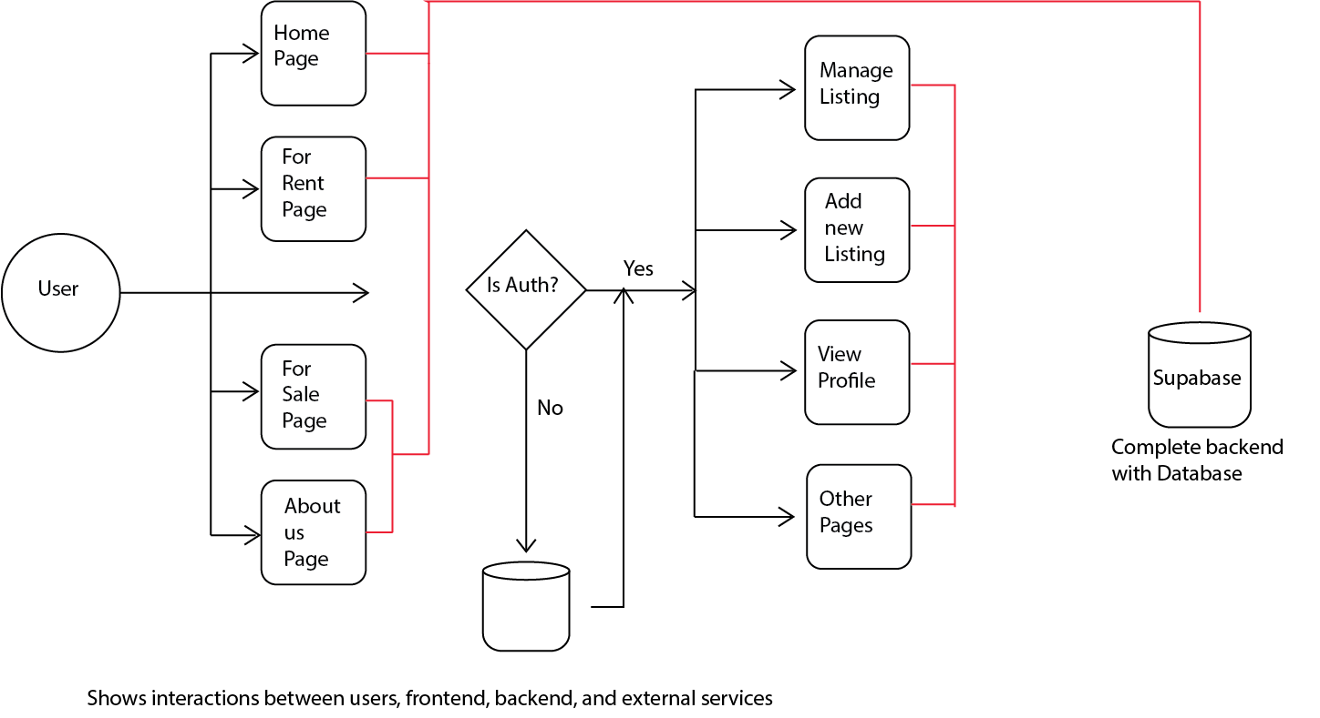

Slide 9
Implementation

Slide 10
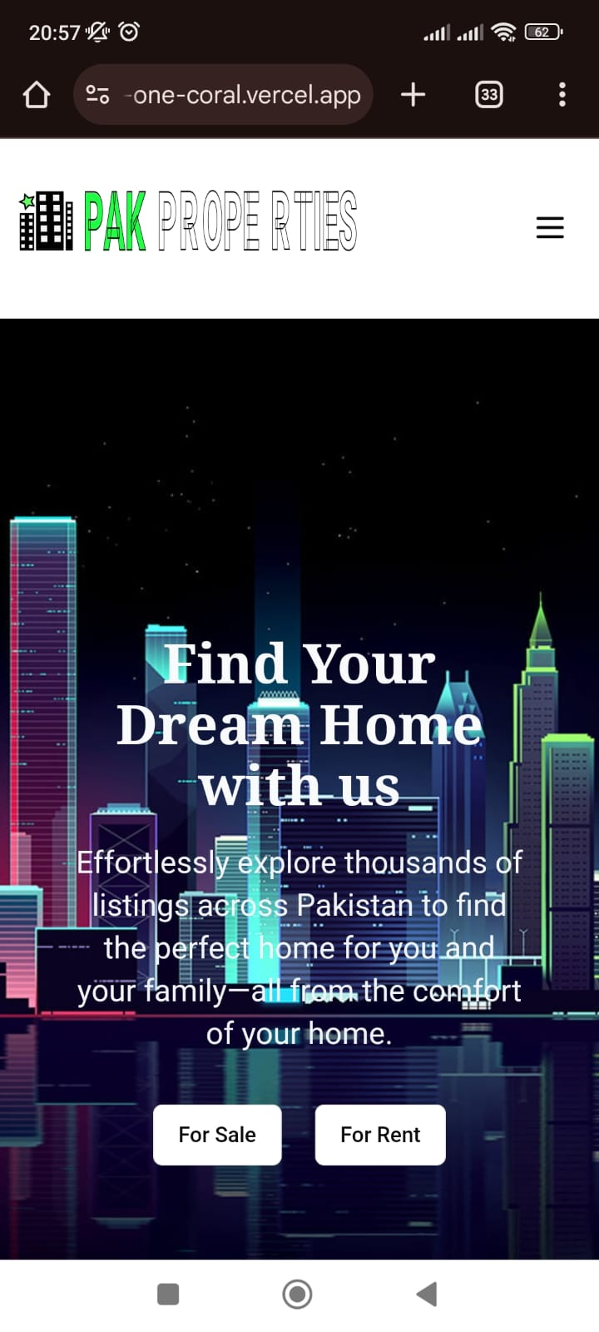
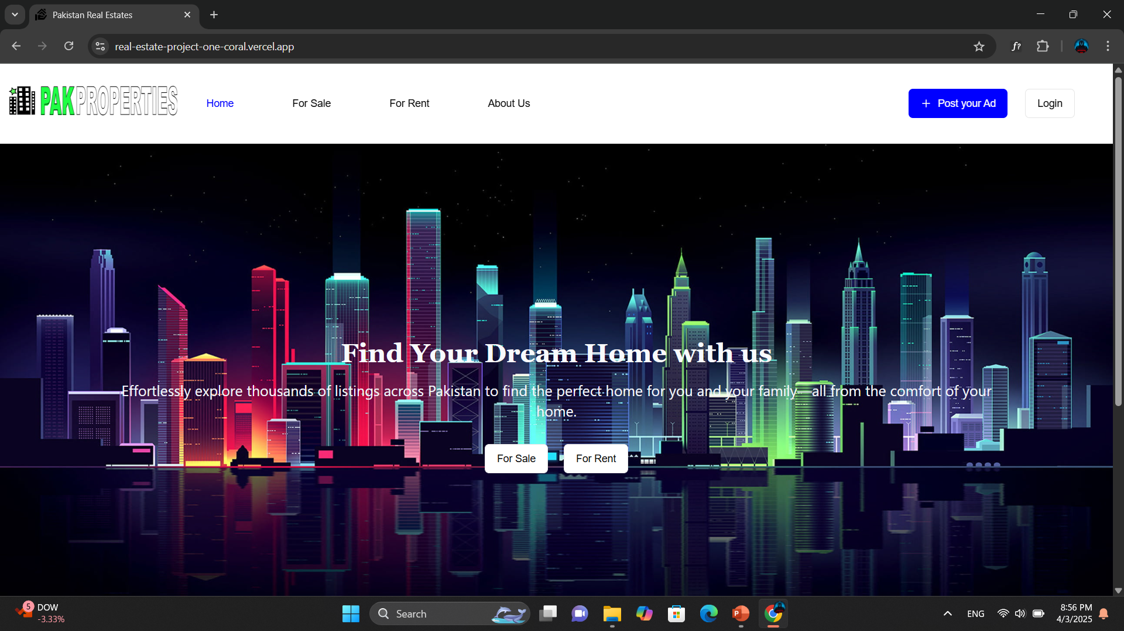
Home Page (Desktop and Mobile view)

Slide 11
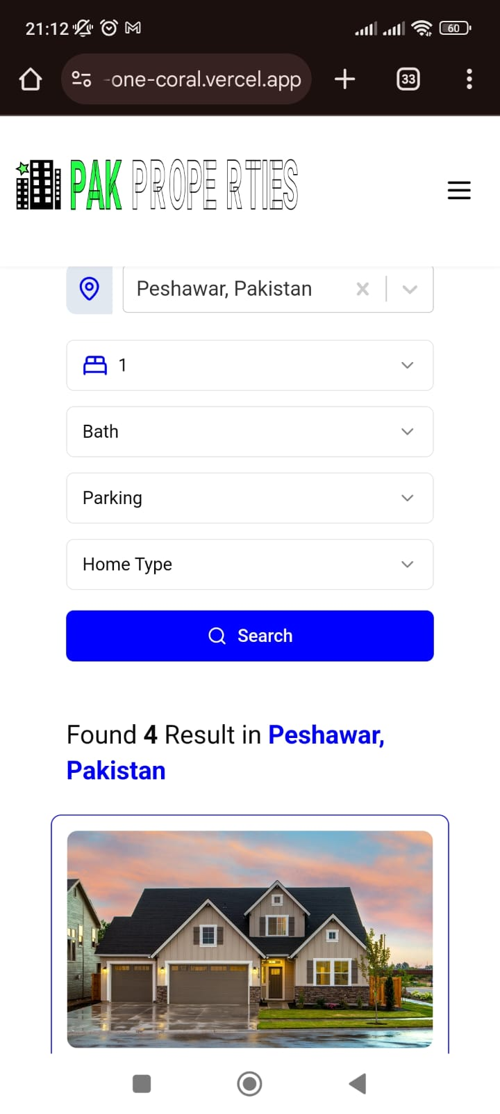
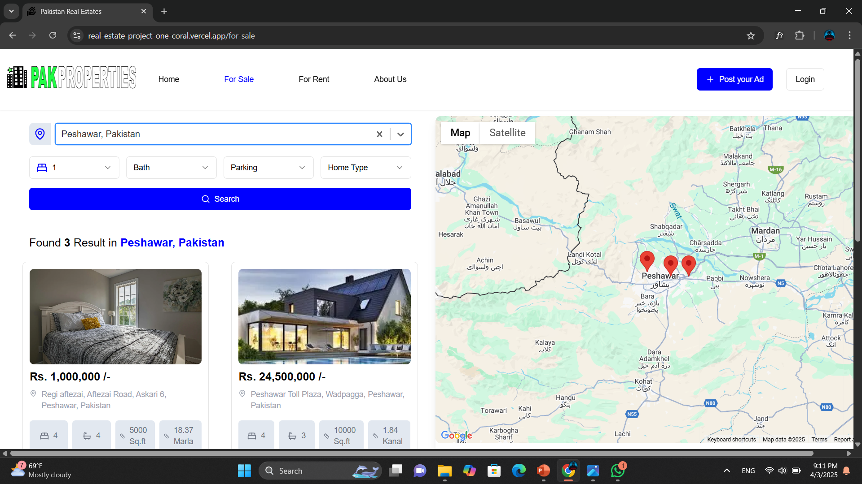
For Sale & For Rent Page (Desktop and Mobile view)

Slide 12
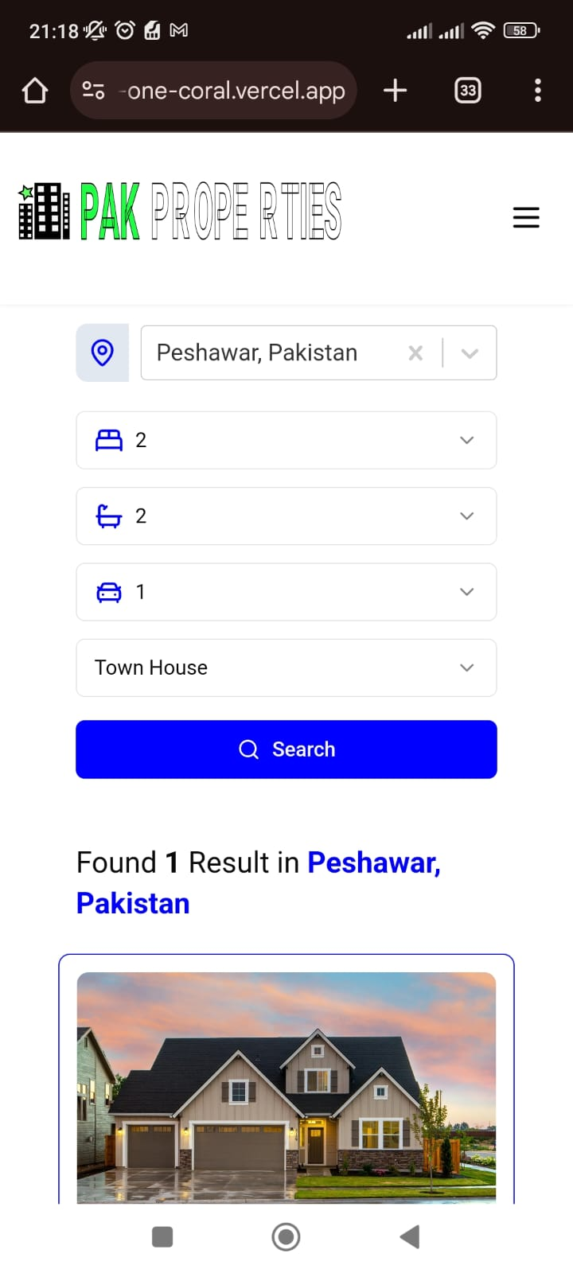
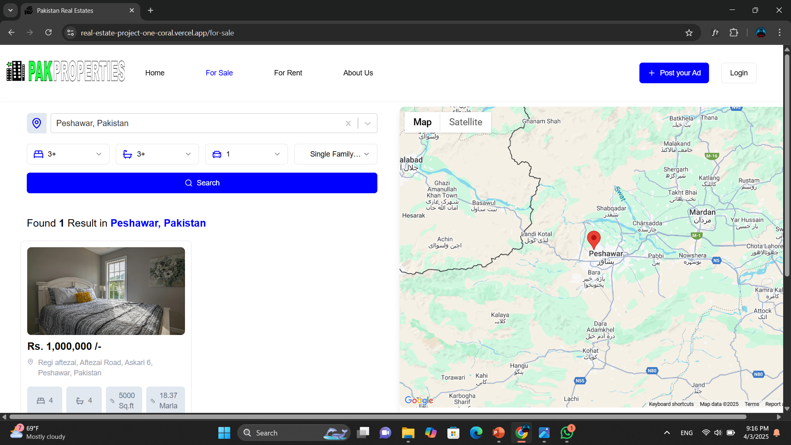
Advance Search

Slide 13
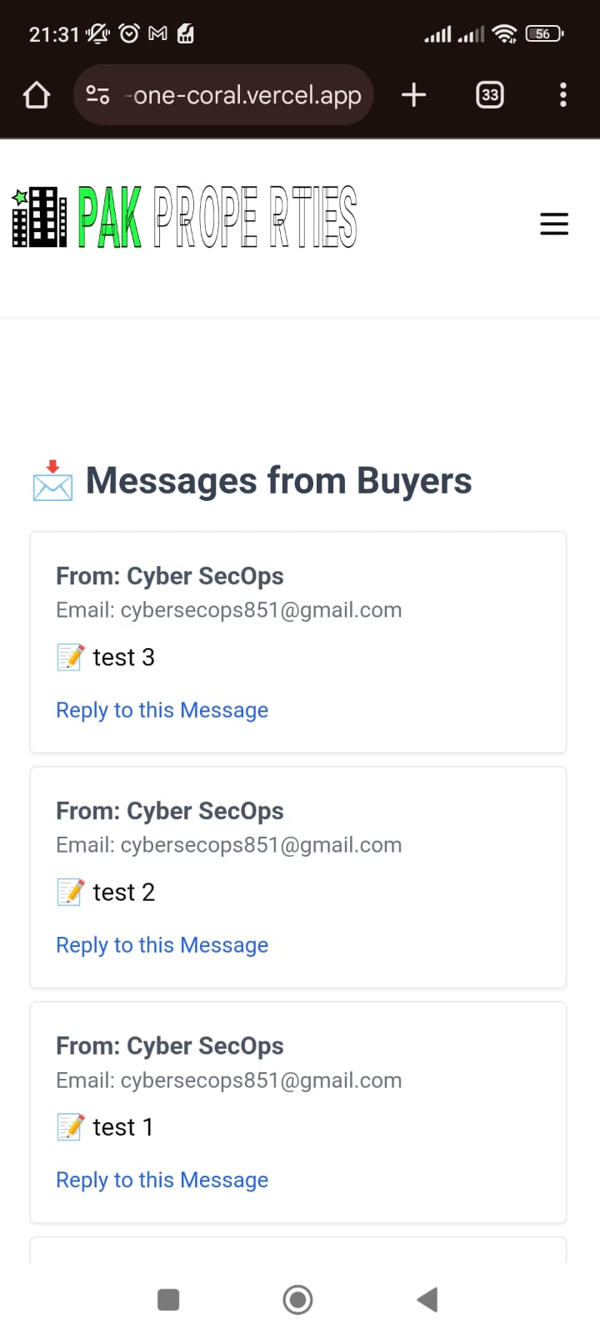
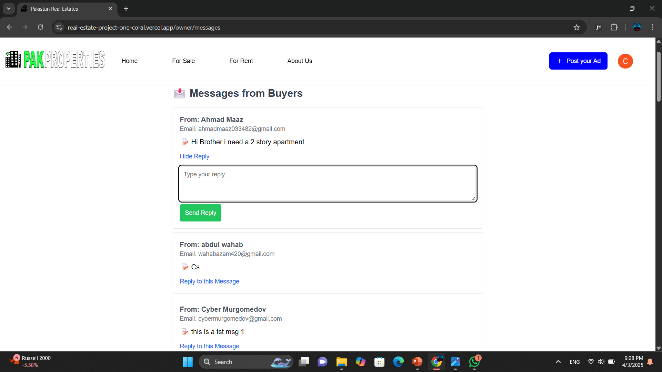
Messaging Functionality

Slide 14
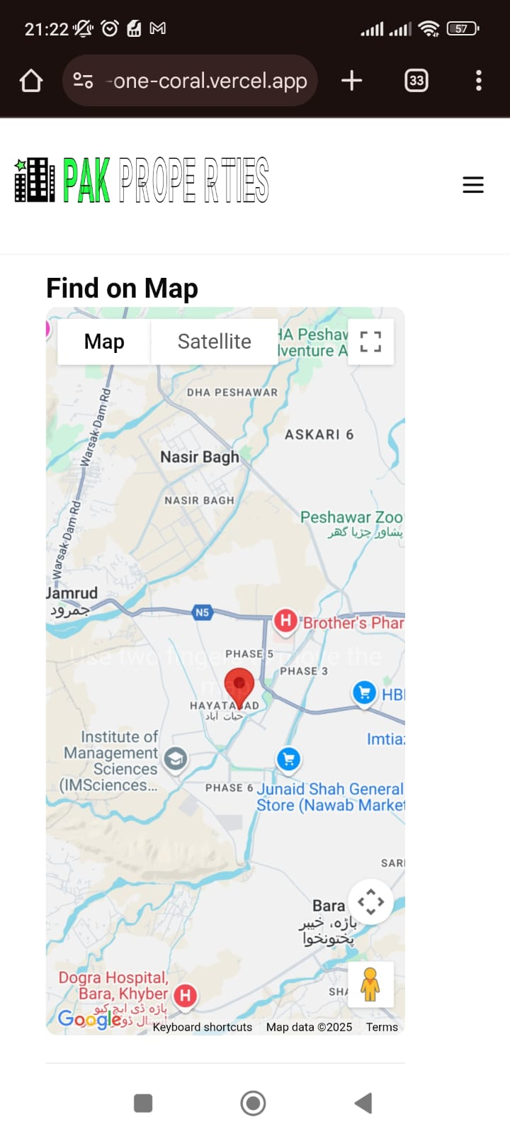
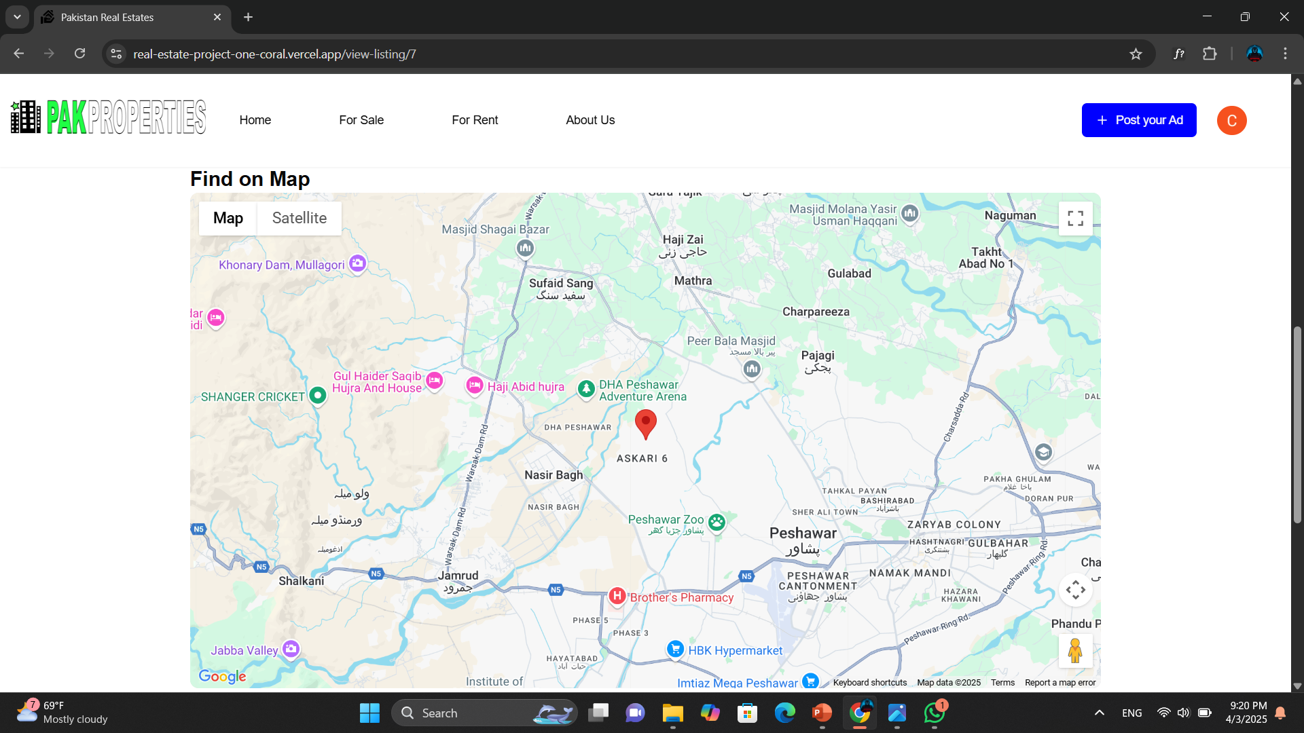
Map Integration (i)

Slide 15
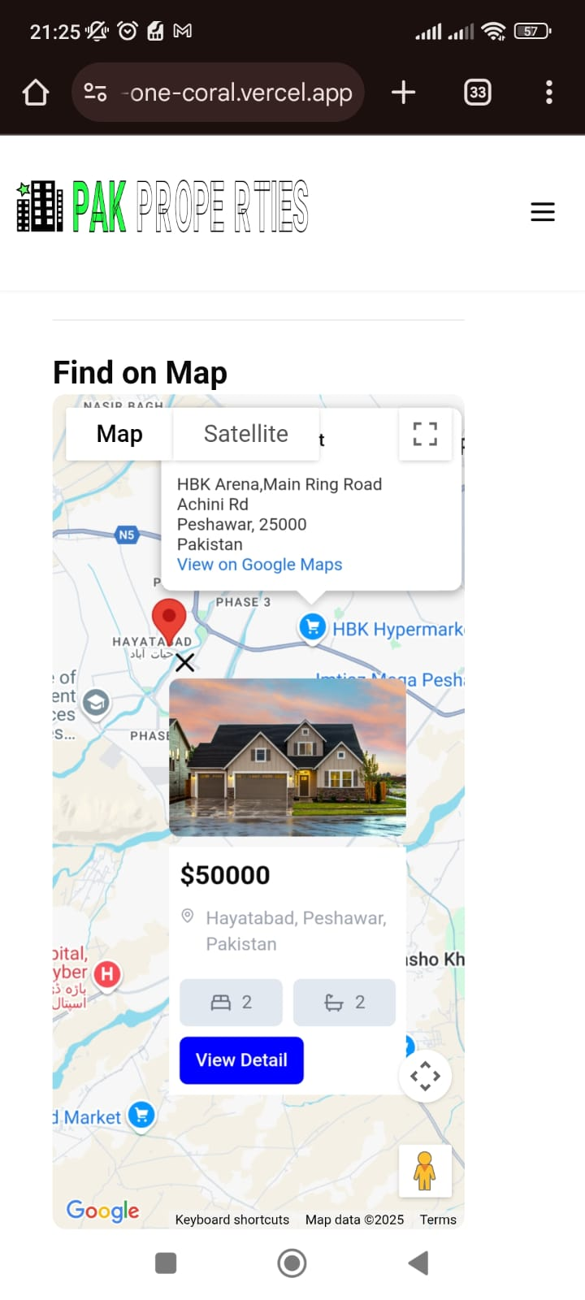
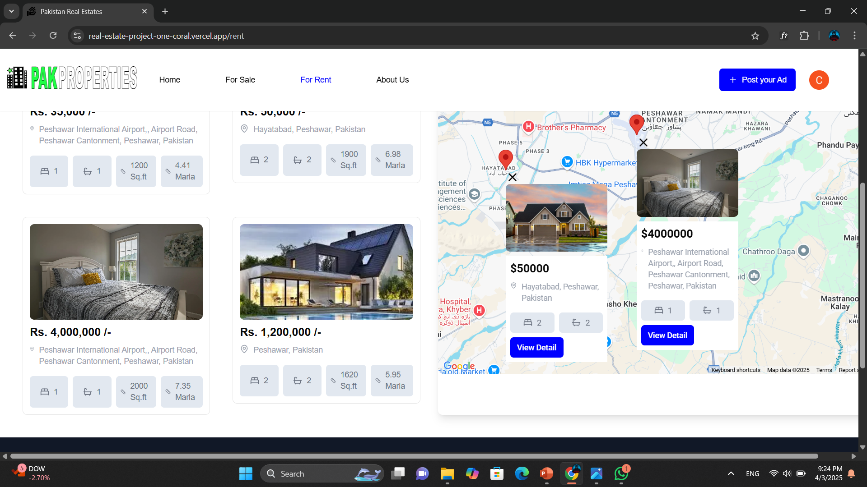
Map Integration (ii)

Slide 16
Challenges and Solutions
1. Mobile Responsiveness & UI Consistency
Challenge: Maintaining a user-friendly experience across different devices.
Solution: Used Tailwind CSS for responsive design and tested layouts extensively.
2. Authentication & User Management
Challenge: Securing user authentication and authorization with minimal friction.
Solution: Integrated Clerk SDK for authentication, offering social logins and secure session management.
3. Implementing Advanced Search Functionality
Challenge: Enabling users to filter listings efficiently based on multiple criteria (price, location, property type, etc.) while maintaining fast performance.
Solution: Optimized Supabase queries with indexed search and implemented dynamic filtering in the frontend for a smooth user experience. Future enhancements could include full-text search or AI-based recommendations.

Slide 17
Challenges and Solutions (ii)
4. Implementing Advanced Search Functionality
Challenge: Enabling users to filter listings efficiently based on multiple criteria (price, location, property type, etc.) while maintaining fast performance.
Solution: Optimized Supabase queries with indexed search and implemented dynamic filtering in the frontend for a smooth user experience. Future enhancements could include full-text search or AI-based recommendations.
5. Real-Time Messaging Without Web Sockets
Challenge: Implementing a real-time messaging system without using Web Sockets or Supabase Realtime, leading to potential delays in message updates.
Solution: Used polling, where the system fetches new messages from the database every 5 seconds. While this method ensures updates, it increases database queries. A future improvement could involve Web Sockets for instant message delivery and reduced server load.

Slide 18
Future Enhancement
Adding online rental payment integration
AI-powered property recommendations
Mobile application development
More refined search filters (e.g., nearby schools, public transport)

Slide 19
Conclusion
The Real Estate Listing Platform successfully provides an efficient and user-friendly way for buyers and sellers to connect.
Implemented advanced search, interactive maps, and messaging to enhance the real estate browsing experience.
Overcame challenges such as real-time messaging without WebSockets, handling large data efficiently, and integrating location-based search.
Future improvements could include WebSocket-based messaging, AI-driven property recommendations, and geospatial search optimizations.
This project demonstrates a scalable, modern web application using Next.js, Supabase, Google Maps API, and Clerk SDK.

Slide 20
Q & A
"Thank You! Any Questions?"

